Slide 1
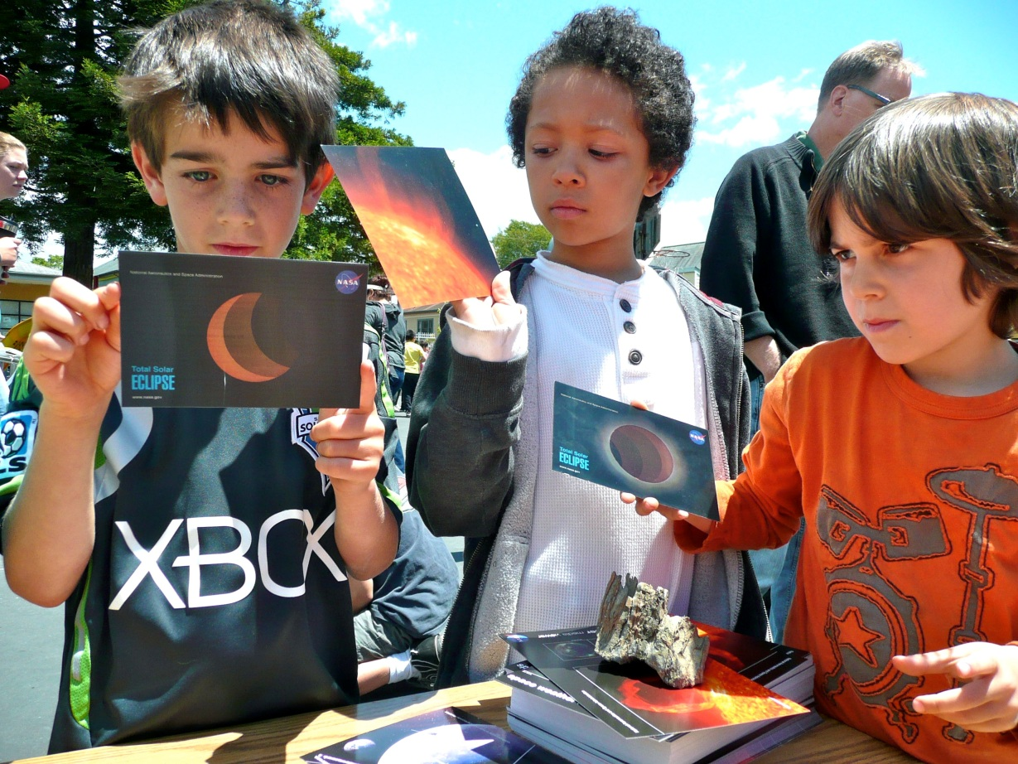
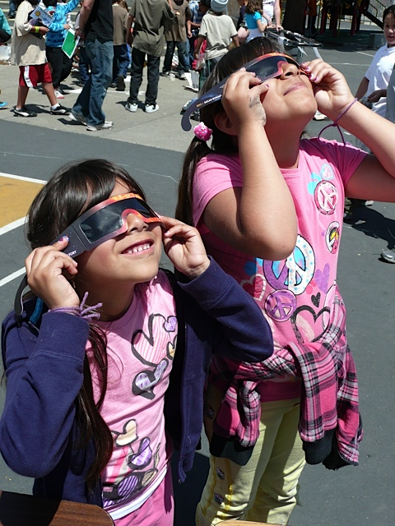
School-Wide Solar Fair
Rosa Parks Elementary School, Berkeley, CA

Slide 2
Rosa Parks Elementary
All grade level implementation
Culminating event
What supports success?
Challenges?

Slide 3
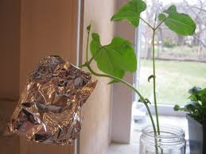
First Grade: observing plants and the Sun
Expand focus to observation and prediction
Experimentation with plants and various sun exposures.
Documented with pictures and whole class project—single large poster containing observations, hypothesis and conclusions

Slide 4
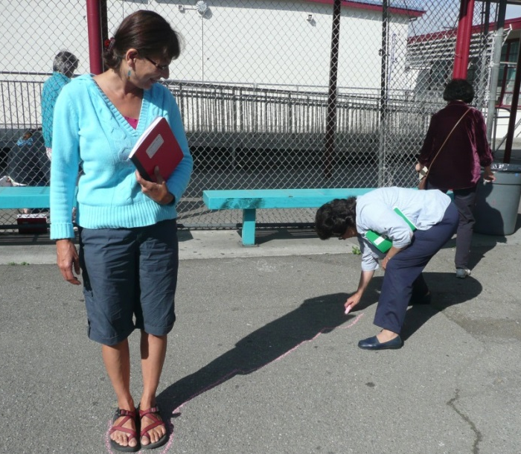
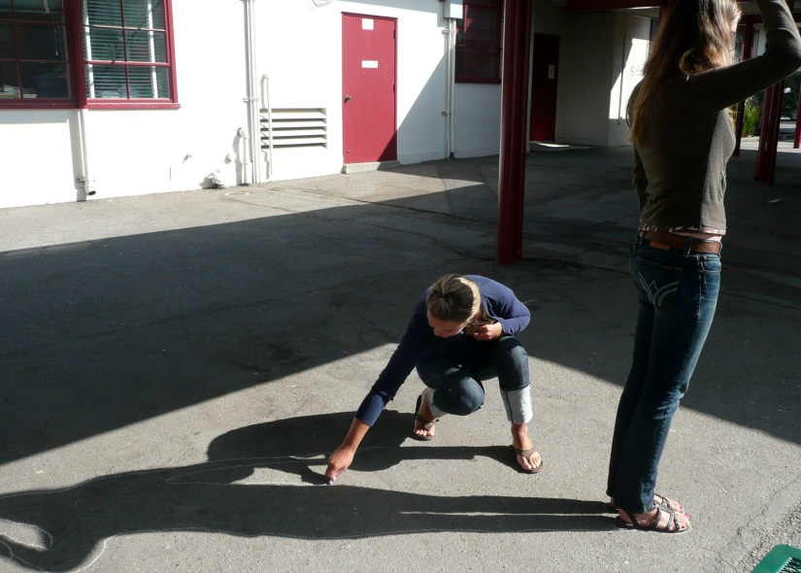
Second Grade: observing changing shadows
Changing Sun in the sky and shadows
Tracked shadows over the day
Eye on the Sky—drawing what you learned.

Slide 5
Third Grade: solar cookers
Pizza box ovens
Experimentation with foil, varied coverings, insulation, angle, placement, and thermometers
Write up of experiment—procedural writing—and summary of findings with conclusion
By-product: healthy snacks!

Slide 6
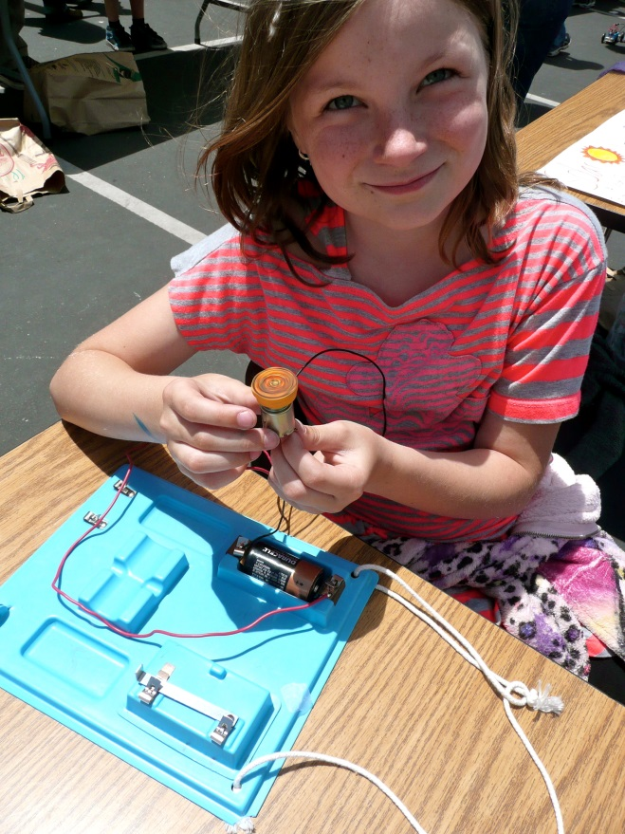
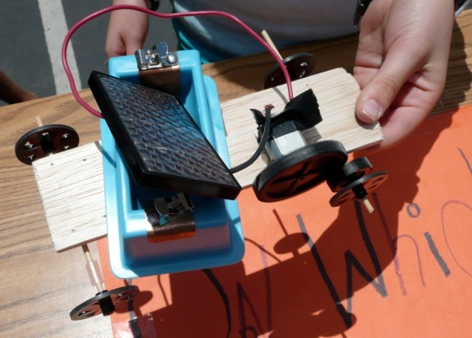
Fourth Grade: solar cars
Authentic planning and design
Hands-on: execution of ideas and engineering
Kits vs. recyclable materials
Parental involvement?

Slide 7
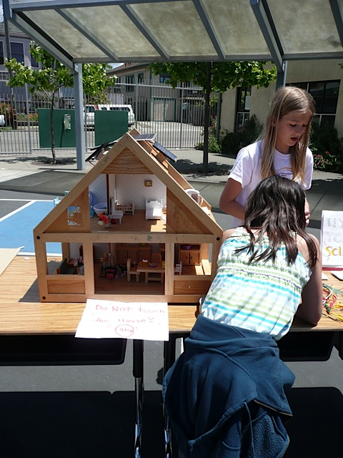
Fifth Grade: passive solar homes
Culminating, integrating activity
Engineering and design
Connections to community
Kits vs recyclables?
Challenges?

Slide 8
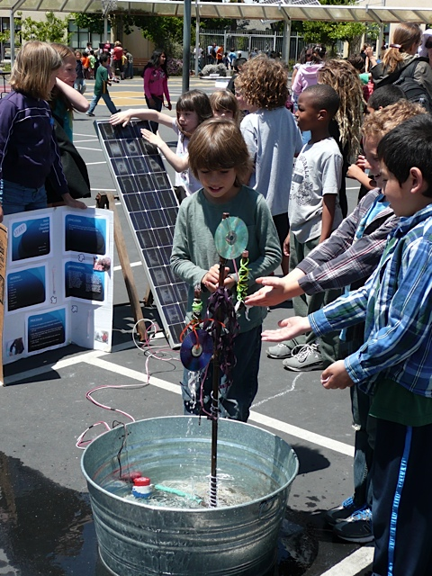
A few details…
Solar Fair is tied to Open House
Thread of observation and experimentation
Students are the presenters; all materials are out!
Students have done the activities as part of their classwork before exhibiting at the solar fair
All grades participate
Augment the classroom activities Kindergarteners and ice castles (solids, liquids etc)

Slide 9
A few more details and challenges
Principal support
Science release teacher or other champion
Parental and family support and contributions
Community involvement
Funds (PG&E Brite Ideas grant highly motivating!)
Lack of deep reflection in the conclusions—stronger link to classroom?
Real world connections…solar suitcase, ovens in other countries?

Slide 10
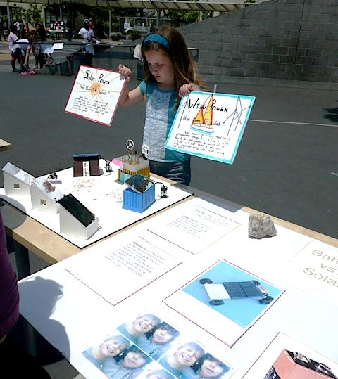
Where is the solar fair today?
Organic evolution—moving toward sustainability and renewable resources…
Windmills, solar hot water heaters, solar fountains, shoebox solar houses, murals with all experiments
Robust connections to NGSS
Bigger and different every year!

